Slide 1

OBJECT ORIENTED PROGRAMMING (OOP)
GROUP N2 OBJECT MASTERS
INTEGRANTS MATEO DAVID CEVALLOS PAGUAY
KEVIN ANTHONY CHALAN YAMBERLA
FERNANDO DANIEL CHICAIZA SAMBACHI
PABLO JOSE COLLAGUAZO NAZATE
NRC 28434

Slide 2
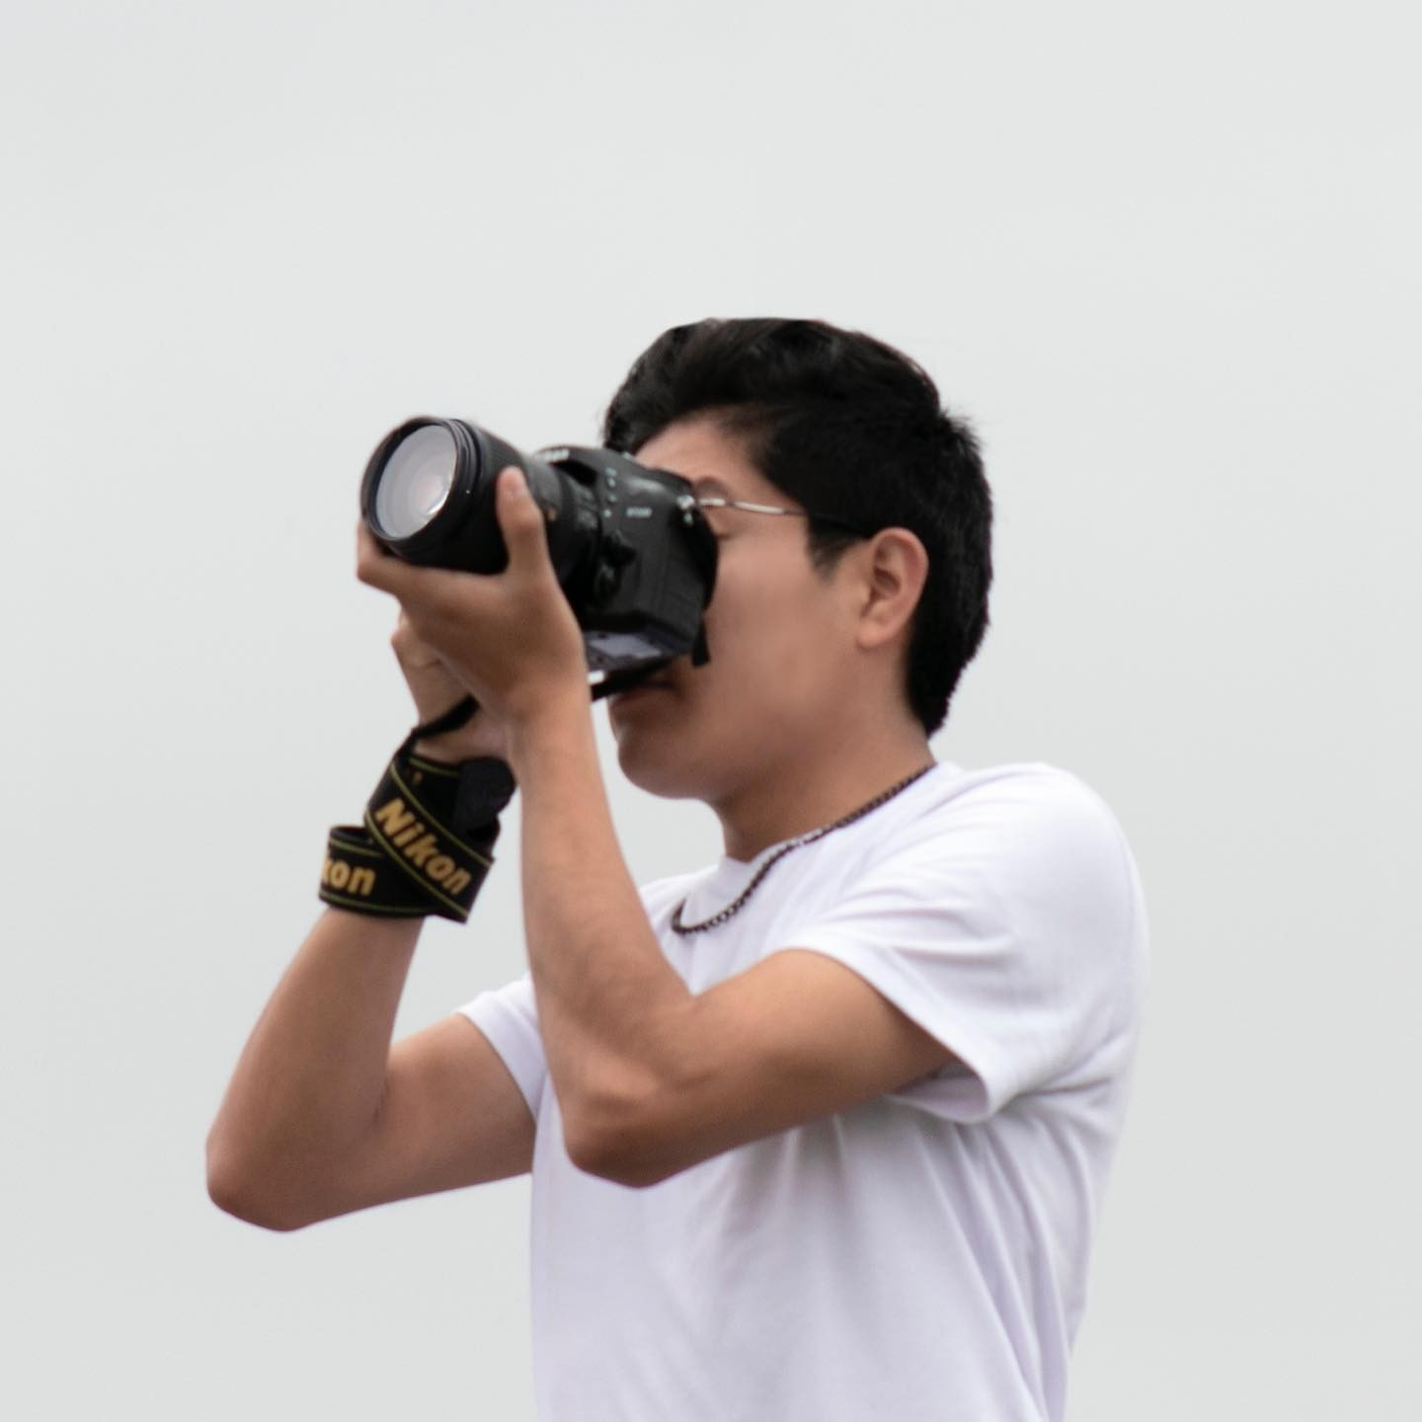
CREALTIVA STUDIO
CREALTIVA STUDIO is a business founded by Alexis Fares from Quito. The idea for his business began with his photography studies. He had worked in other studios but decided to start his own business. Crealtiva Studios has been operating for two years. Alexis Fares and his group of friends started this business with Alexis as the leader.

Slide 3
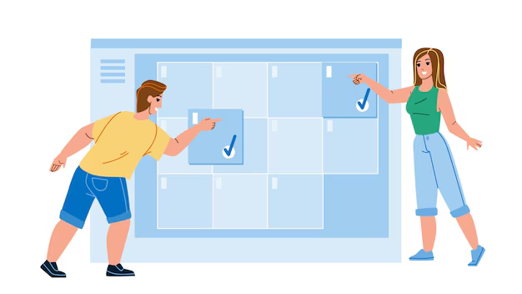

PROBLEM
Alexis identification various difficulties to the hour of manage his business of manually form how
Organization deficient of events dates
Lost of media files
Manage of payments confused
This problems demonstrate the need of automate the gestion of studio by a program of desktop

Slide 4

OVERVIEW
The desktop program will centralize client, appointment, order, and media file management using Object-Oriented Programming (OOP).
Organize appointments automatically
Track orders and payments,
Store media files in an orderly way.

Slide 5
Background
By applying a desktop solution based on OOP, the studio can structure its information into classes such as Client, Appointment, Order, MediaFile, and Payment. This approach
Efficient planning
Better tracking of services
Improved overall management
Laying the foundation for potential future expansions like web or remote access.

Slide 6
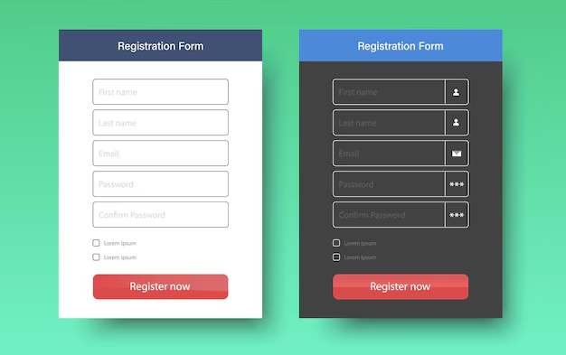
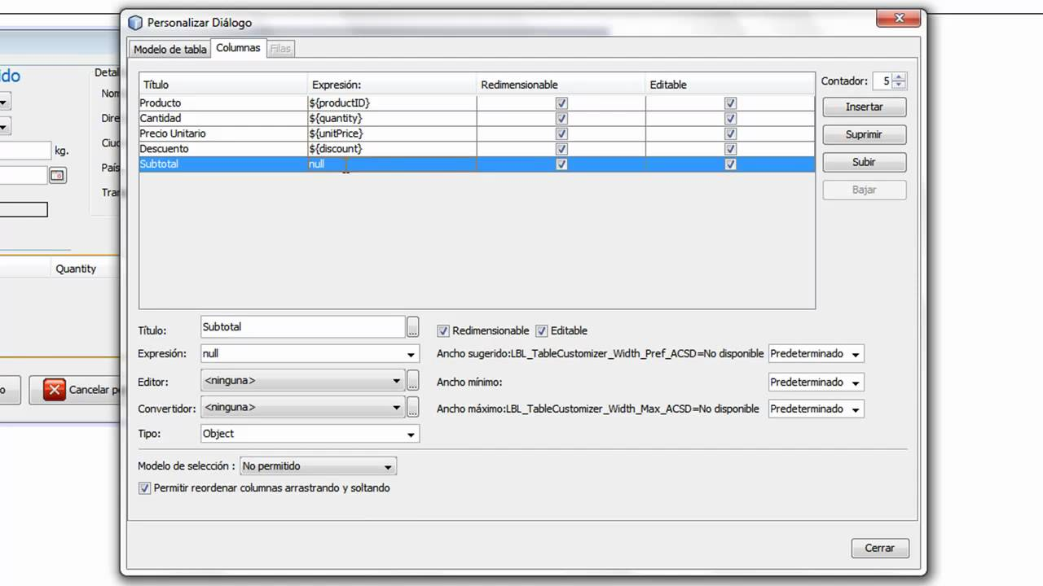
Example a desktop application.

Slide 7

Some photographs of Crealtiva Studio

Slide 8
THANK YOU

